Slide 1
PPS MINI PROJECT
LIBRARY MANAGEMENT SYSTEM

Slide 2

ABOUT US
YASH RANA(RA2111003011796)
THAMMICHETTY NIHAS(RA2111003011796)

Slide 3

Problem statement:
A library database system is an infrastructure that allows users to search books and book content, add/remove, and download selected books. The problem faced is that library users require an efficient method to find a specific book or keyword(s) within a book given a continuously expanding library.

Slide 4
DESCRIPTION:
The library management system software makes the library a smart one by organizing the books systematically by author, title and subject. This enables users to search for books quickly and effortlessly.
THIS SYSTEM PROVIDES THE ACCESS TO THE CUSTORMER/LIBRARIAN-
TO ADD THE BOOK INFORMATION
TO DISPLAY ALL THE BOOK INFORMATION
TO KNOW THE TOTAL NO. OF BOOKS IN THE LIBRARY
The following presentation provides the specification for the system.

Slide 5
AlGORITHM:
Step 1: Start
Step 2: Declare a structure which holds data members
Step 3: declare variables which are used for loop
Step 4: use switch case to work on each module
Step 5: case 1- for Adding book information
Case 2- for Display book information
Case 3- for Finding number for books in library
Case 4- for EXIT
Step 6: Stop

Slide 6
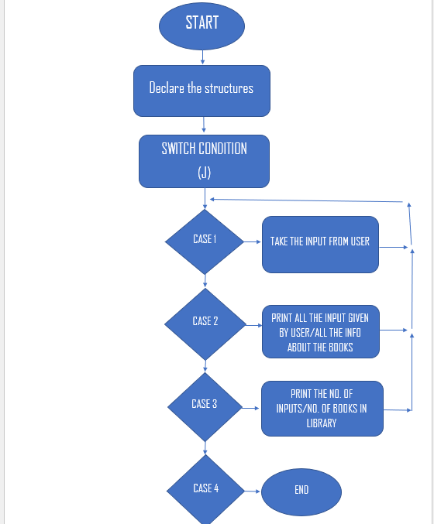
flowchart:

Slide 7

THE CODE

Slide 9


Slide 10

OUTPUT

Slide 13
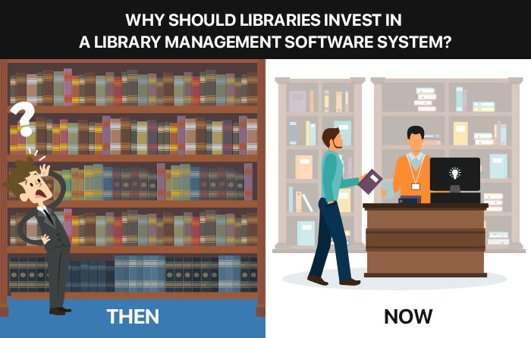
THANK YOU!

